Slide 1

WalletWatch
Chandler
Stevens
David
Ang
Jason
Djajasasmita
Matthew
Paik

Slide 2

User Interface

Slide 3
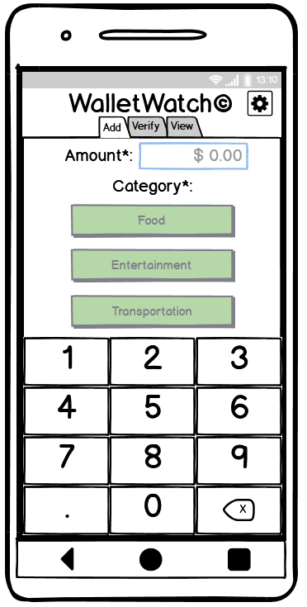
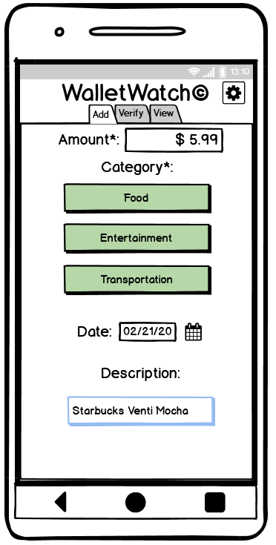
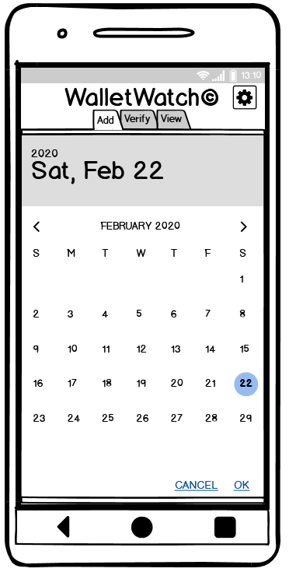
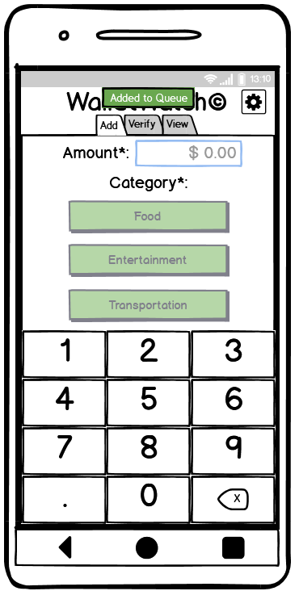
Tab 1: Add Entry

Slide 4
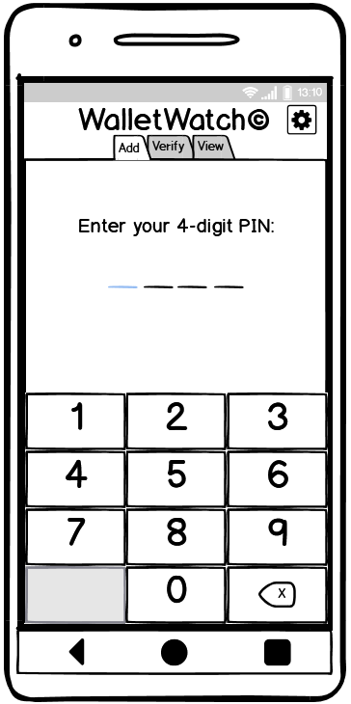
PIN Verification

Slide 5
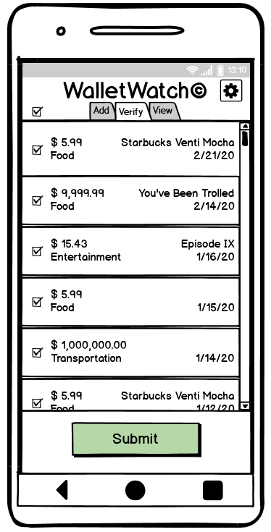
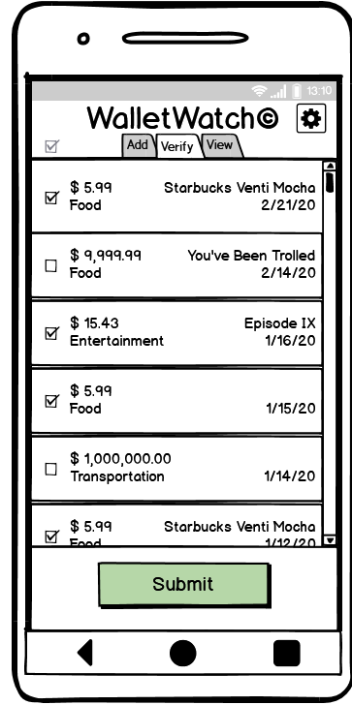
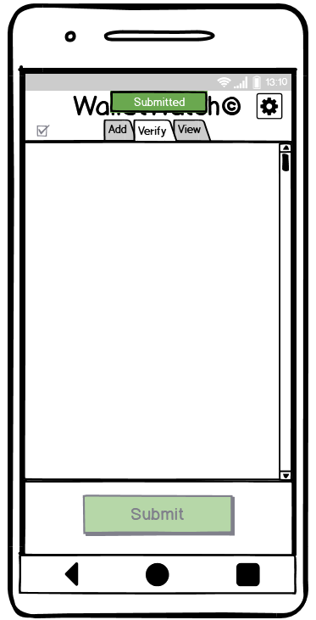
Tab 2: Verify Entries

Slide 6
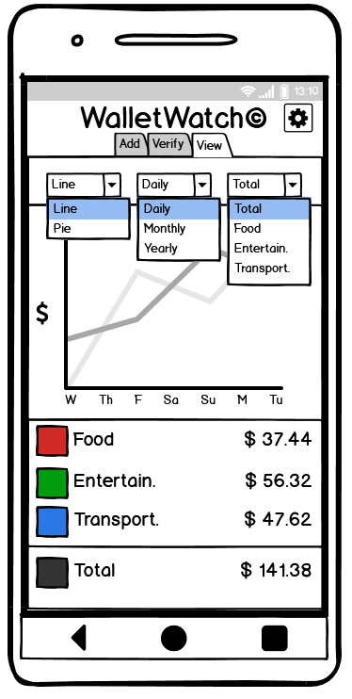
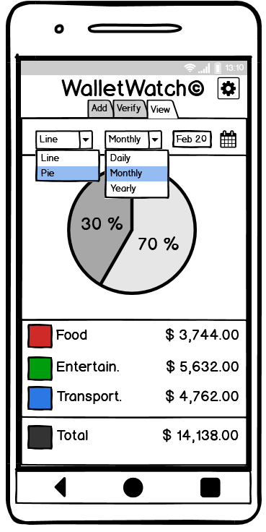
Tab 3: View Analytics

Slide 7
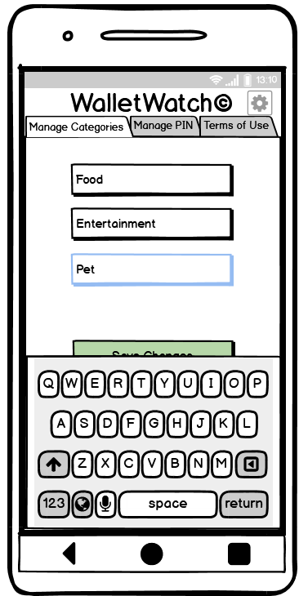
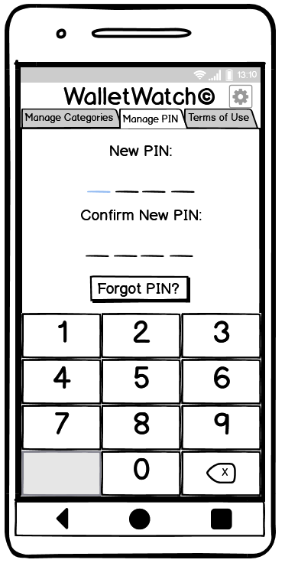
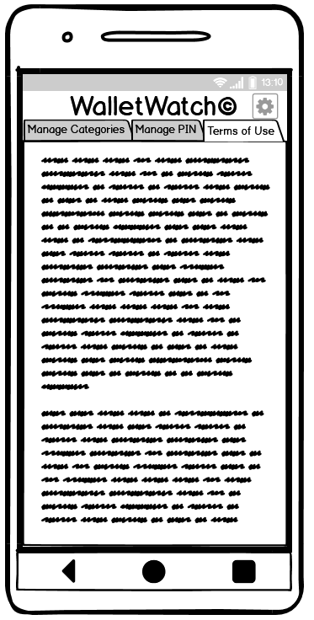
Settings

Slide 8
Data Model

Slide 9
Encrypted XML File (Security Section)
<?xml version="1.0" encoding="UTF-8"?>
<root>
<security>
<pin>1234</pin>
<question>What city were you born in?</question>
<answer>Seattle</answer>
</security>
...

Slide 10
Encrypted XML File (Data Section)
...
<data>
<total>133.00</total>
<category id="1">
<label>Food</label>
<total>7.00</total>
<year id="2019">
<total>7.00</total>
<month id="2">
<total>7.00</total>
<day id="13">
<total>7.00</total>
...
…
<entry id="1">
<amount>5.00</amount>
<description>Coffee</description>
</entry>
<entry id="2">
<amount>2.00</amount>
<description></description>
</entry>
...

Slide 11
Contact Us
Questions?
Let us know at paikm@spu.edu
Track our progress @ https://github.com/matt2849/CSC4151

